Slide 1
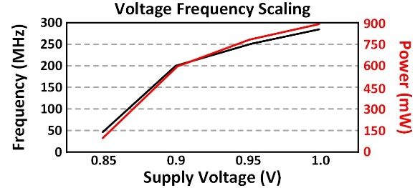
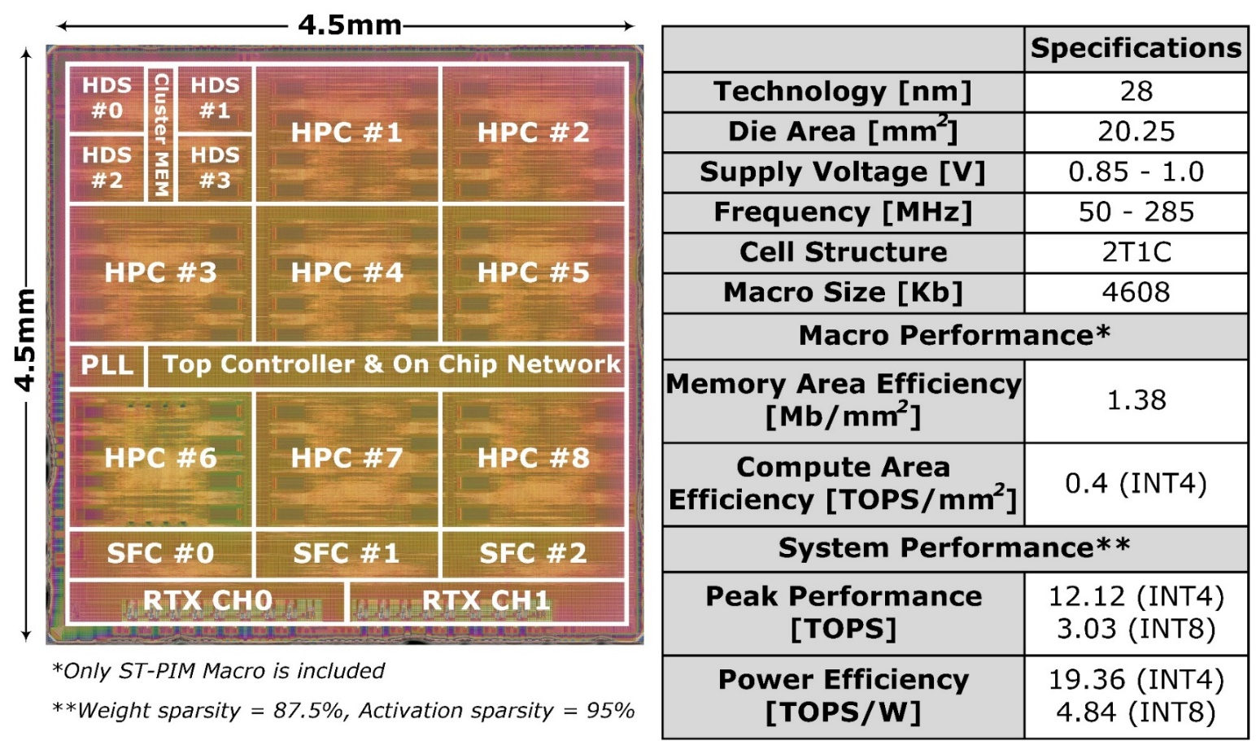
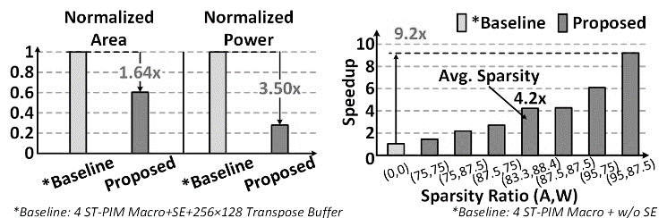
DPIM: A 19.36 TOPS/W 2T1C eDRAM Transformer-in-Memory Chip
with Sparsity-Aware-Quantization and Heterogeneous Dense-Sparse Core
Adiwena Putra, Hyunjun Cho, Seungjae Yoo, Hangyeol Kim, MuYoung Son, Sungwoong Yune,
Cuong Duong Manh, Jaeho Jeon, and Joo-Young Kim
Department of Electrical Engineering, Korea Advance Institute of Science and Technology (KAIST)
Abstract
DPIM is a 28-nm 2T1C eDRAM-based transformer accelerator targeting key PIM limitations. It integrates sparsity-aware quantization and a heterogeneous core to support both dense and sparse computation. The design achieves high efficiency (up to 19.36 TOPS/W) and throughput (12.12 TOPS), enabling full BERT-Large execution with up to 115.8× higher density than prior work.
Architecture
Heterogenous PIM clusters with specialized function cluster for end-to-end execution.
Chip & Measurement Results (BERT-large)
Conclusion
DPIM demonstrates a sota PIM transformer accelerator, achieving end-to-end BERT-Large inference with up to 12.12 TOPS throughput, 19.36 TOPS/W energy efficiency, 1,413 kb/mm² memory density, and 1.6×–115.8× improvement in density figure-of-merit over prior designs.

